Slide 1
Database Manager
A program module which provides the interface between the low-level data stored in the database and the application programs and queries submitted to the system.
Databases typically require lots of storage space gigabytes. This must be stored on disks. Data is moved between disk and main memory MM as needed.

Slide 2
Database Manager cont..
Database Manager module is responsible for
Interaction with the file manager
Storing raw data on disk using file system
Integrity enforcement
Do not violate consistency constraints
Security enforcement
Ensure user access to information they are permitted to
Backup and Recovery
Detecting failures due to power failure, disk crash,etc and restoring the database to its state before the failure
Concurrency control
Preserving data consistency when there are concurrent users

Slide 3
Database Administrator
Is person having central control over data and program accessing that data
Duties of administrator
Database design
Scheme definition
User authorization

Slide 4
Database Users
Application programmers
Computer professionals
Interacts with the system through programming commonly using host language (java,c#,etc)
Host language compiler generates object code
Sophisticated users
Interacts with the system without writing programs
Requests by writing queries in a database query language
Query submitted to query processor that breaks DML statement down into instructions for database manager module

Slide 5
Database Users contd…
Specialized users
Are sophisticated users writing special database application programs.
Complex database systems (audio/video), Knowledge-based experts systems, etc
Naive users
Unsophisticated users who interacts with the system by using permanent application programs (eg. ATM)

Slide 6
Overall System Structure
File Manager
Allocation of disk space & data structure on disk
Database manager
Interface between low-level data & application program and queries
Query Processor
Translates statements in a query language to low-level instruction that db manager understands
DML precompiler
Converts DML statement in application program to normal procedure calls in host language

Slide 7
Overall System Structure cont..
DDL Compiler
Converts DDL statements to a set of tables containing metadata stored in a data dictionary
Data Files – stores the data itself
Data Dictionary – stores information about the structure of the database. It is used heavily
Indices – provides fast access to data items holding particular values.

Slide 8
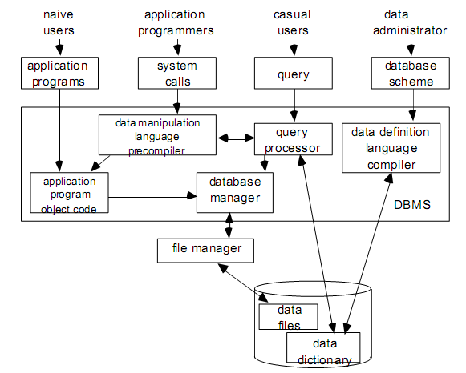
Overall System Structure

Slide 9
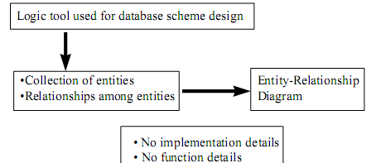
Entity-Relationship Model
E-R Model views the real world as a set of basic objects (entities) and relationship among these objects.
Represents overall logical structure of the DB

Slide 10
Entity
An Entity is an object (something) that exists and is distinguishable from other objects (things)
Independent existence
Described by its attributes (set of properties)
Determined by particular value of its attributes
Can be concrete or abstract
Example
A book
Title=“Database system concept”,pages=820,ISBN=xxxxxxxx
A person
Name=“Suman Ghimire”,age=28,Citizen No=xxxxxx
A holiday
Name=“Christmas”,date=December 25

Slide 11
Entity Set
An entity set is a set of entities of the same type; entities that share the same properties
Example
A set of books
A set of people taking DBMS
Entity set need not be disjoint.
For eg. The entity set employee all employees of a bank an the entity set customer all customers of the bank may have members in common.

Slide 12
Attributes
An entity is represented by a set of attributes i.e descriptive properties possessed by all members of an entity set
Example
Student (StudentID,Name,Address,Class,Grade)
Course(Number,Title,Classroom,instructor)
Domain
Domain of an attribute is a set of permitted values for each attribute
Example
Attribute Age is a number between 0 and 200
Color is one of { blue,green,black,…)

Slide 13
Attribute types
Single value vs Multi valued
Single : Social Insurance Number, student number
Multi: Telephone Numbers, Lectures of a course,..
Simple vs Composite
Composite: Address = Apt No, Street, City, Postal Code
Null Value
No corresponding values (contain no value)
Stored vs Derived
Stored: Individual mark of a student
Derived: Overall grade of a student

Slide 14
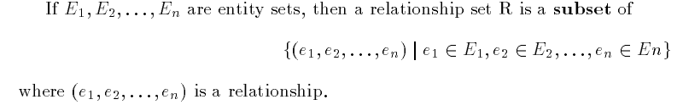
Relationships & Relationship Sets
A relationship is an association between several entities.
A relationship set is a set of relationships of the same type.
Eg. CustAcc relationship between customer & Account
CustAcc is a subset of all possible customer & account pairings

Slide 15
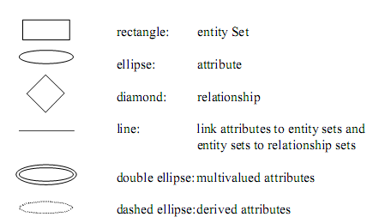
Notation

Slide 16
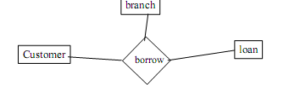
Degree of relationship set
Refers to the number of entity sets that participate in a relationship set
Relationship that involve two entity sets are called binary
Relationship may involve more than 2 entity sets
The entity set customer, loan and branch may be linked by a ternary relationship.

Slide 17
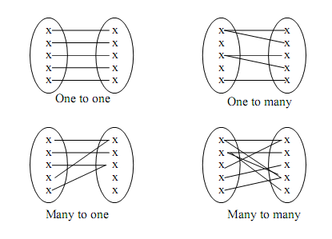
Mapping cardinalities
Express the number of entities to which another entity can be associated via a relationship set
One to one
One to many
Many to one
Many to many

Slide 18
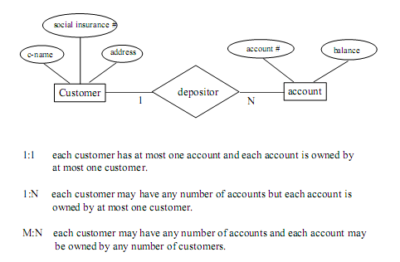

Slide 19
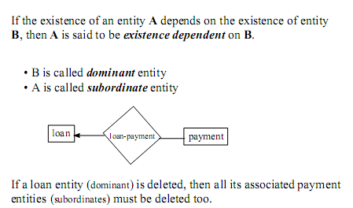
Existence Dependencies

Slide 20

Entity set Keys
For eg. Entity set Customer, customer-name & SIN is a super key.
Customer name alone is not, as two customers could have same name
In above example SIN is a candidate key, as it is minimal, and uniquely identifies a customer entity

Slide 21
Primary key is a candidate key chosen by the db designer to identify entities in an entity set.
Weak Entity Sets
An entity set that does not have a primary key is referred to as a weak entity set.
Strong Entity Set
One that does have a primary key is called strong entity set

